Slide 1
Fontstyle detection on CNNs
Alexander Taubert

Slide 2
Fontstyle detection on CNNs
Benefits
Neighborhood correlation
Efficiency (small and accurate)
Drawbacks
Sensitive
Fast or nothing

Slide 3
Fontstyle detection on CNNs
Imageformat 1200 x 40 x 3 (w x h x c)
Labels 1-12 (Fontstyles)
Arial
Calibri
Canterbury
Comic_san_ms
Courier_new
Forte
Jokerman
Monofont
Times_new_roman
Times_new_romance
Unispace_rg
Waltograph_ui

Slide 4
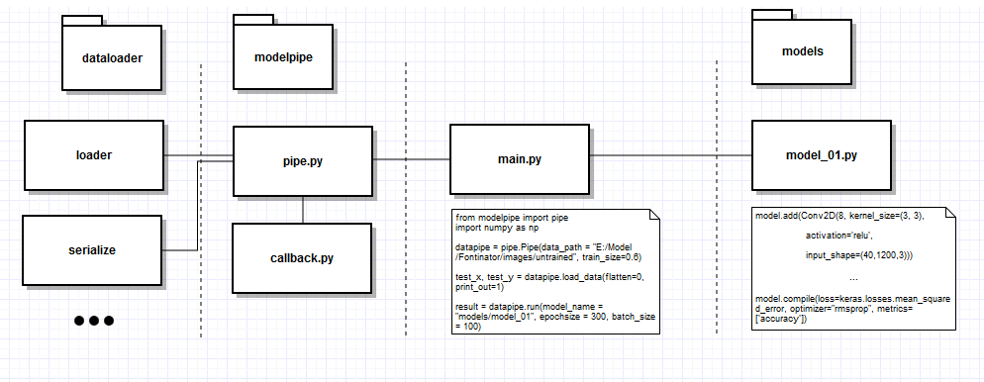
Fontstyle detection on CNNs

Slide 5
Fontstyle detection on CNNs

Slide 6
Model 1 – Basic Model
model.add(Conv2D(8, kernel_size=(3, 3), activation='relu‘, input_shape=(40,1200,3)))
model.add(MaxPooling2D(pool_size=(2, 2)))
model.add(Conv2D(16, kernel_size=(3, 3), activation='relu'))
model.add(MaxPooling2D(pool_size=(2, 2)))
model.add(Conv2D(24, kernel_size=(3, 3), activation='sigmoid'))
model.add(MaxPooling2D(pool_size=(2, 2)))
model.add(Dropout(0.2))
model.add(Flatten())
model.add(Dense(256, activation='relu'))
model.add(Dropout(0.4))
model.add(Dense(len(classes), activation='softmax'))
model.compile(loss=keras.losses.mean_squared_error, optimizer="rmsprop", metrics=['accuracy'])

Slide 7
Model 2 – 5x5 Kernel
model.add(Conv2D(8, kernel_size=(5, 5), activation='relu‘, input_shape=(40,1200,3)))
model.add(MaxPooling2D(pool_size=(2, 2)))
model.add(Conv2D(16, kernel_size=(3, 3), activation='relu'))
model.add(MaxPooling2D(pool_size=(2, 2)))
model.add(Conv2D(24, kernel_size=(3, 3), activation='sigmoid'))
model.add(MaxPooling2D(pool_size=(2, 2)))
model.add(Dropout(0.2))
model.add(Flatten())
model.add(Dense(256, activation='relu'))
model.add(Dropout(0.4))
model.add(Dense(len(classes), activation='softmax'))
model.compile(loss=keras.losses.mean_squared_error, optimizer="rmsprop", metrics=['accuracy'])

Slide 8
Model 3 – 9x9 Kernel
model.add(Conv2D(8, kernel_size=(9, 9), activation='relu‘, input_shape=(40,1200,3)))
model.add(MaxPooling2D(pool_size=(2, 2)))
model.add(Conv2D(16, kernel_size=(3, 3), activation='relu'))
model.add(MaxPooling2D(pool_size=(2, 2)))
model.add(Conv2D(24, kernel_size=(3, 3), activation='sigmoid'))
model.add(MaxPooling2D(pool_size=(2, 2)))
model.add(Dropout(0.2))
model.add(Flatten())
model.add(Dense(256, activation='relu'))
model.add(Dropout(0.4))
model.add(Dense(len(classes), activation='softmax'))
model.compile(loss=keras.losses.mean_squared_error, optimizer="rmsprop", metrics=['accuracy'])

Slide 9
Model 4 – Extra Conv2D Layer
model.add(Conv2D(8, kernel_size=(3, 3), activation='relu‘, input_shape=(40,1200,3)))
model.add(MaxPooling2D(pool_size=(2, 2)))
model.add(Conv2D(16, kernel_size=(3, 3), activation='relu'))
model.add(MaxPooling2D(pool_size=(2, 2)))
model.add(Conv2D(24, kernel_size=(3, 3), activation='sigmoid‘))
model.add(Conv2D(24, kernel_size=(3, 3), activation='sigmoid'))
model.add(MaxPooling2D(pool_size=(2, 2)))
model.add(Dropout(0.2))
model.add(Flatten())
model.add(Dense(256, activation='relu'))
model.add(Dropout(0.4))
model.add(Dense(len(classes), activation='softmax'))
model.compile(loss=keras.losses.mean_squared_error, optimizer="rmsprop", metrics=['accuracy'])

Slide 10
Model 5 – Extra Dense Layer
model.add(Conv2D(8, kernel_size=(3, 3), activation='relu‘, input_shape=(40,1200,3)))
model.add(MaxPooling2D(pool_size=(2, 2)))
model.add(Conv2D(16, kernel_size=(3, 3), activation='relu'))
model.add(MaxPooling2D(pool_size=(2, 2)))
model.add(Conv2D(24, kernel_size=(3, 3), activation='sigmoid'))
model.add(MaxPooling2D(pool_size=(2, 2)))
model.add(Dropout(0.2))
model.add(Flatten())
model.add(Dense(256, activation='relu‘))
model.add(Dense(256, activation='relu'))
model.add(Dropout(0.4))
model.add(Dense(len(classes), activation='softmax'))
model.compile(loss=keras.losses.mean_squared_error, optimizer="rmsprop", metrics=['accuracy'])

Slide 11
Model 6 – Less Filters
model.add(Conv2D(4, kernel_size=(3, 3), activation='relu‘, input_shape=(40,1200,3)))
model.add(MaxPooling2D(pool_size=(2, 2)))
model.add(Conv2D(8, kernel_size=(3, 3), activation='relu'))
model.add(MaxPooling2D(pool_size=(2, 2)))
model.add(Conv2D(16, kernel_size=(3, 3), activation='sigmoid'))
model.add(MaxPooling2D(pool_size=(2, 2)))
model.add(Dropout(0.2))
model.add(Flatten())
model.add(Dense(256, activation='relu'))
model.add(Dropout(0.4))
model.add(Dense(len(classes), activation='softmax'))
model.compile(loss=keras.losses.mean_squared_error, optimizer="rmsprop", metrics=['accuracy'])

Slide 12
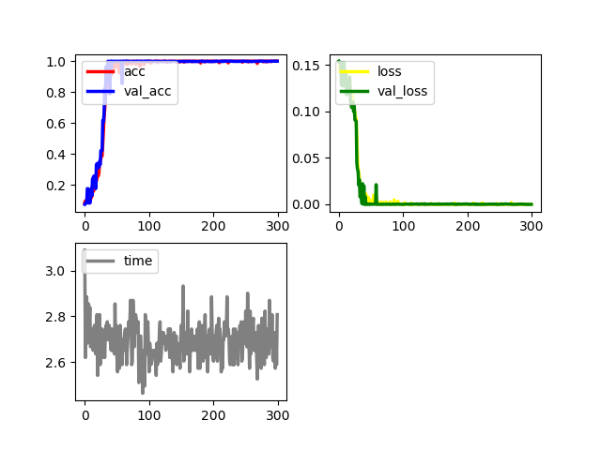
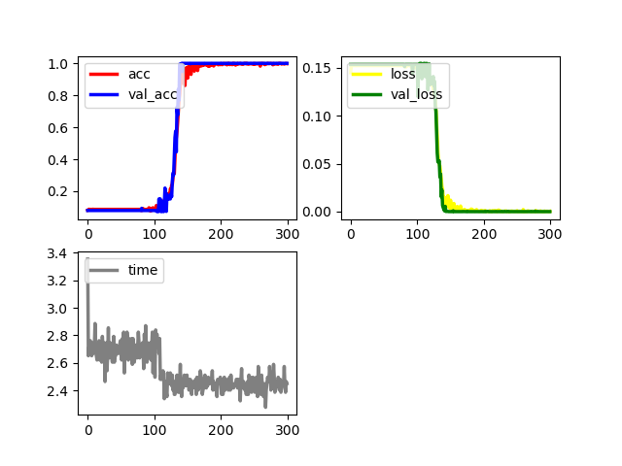
Fontstyle detection on CNNs
Model 1 – Basic Model
Model 2 – 5x5 Kernel

Slide 13
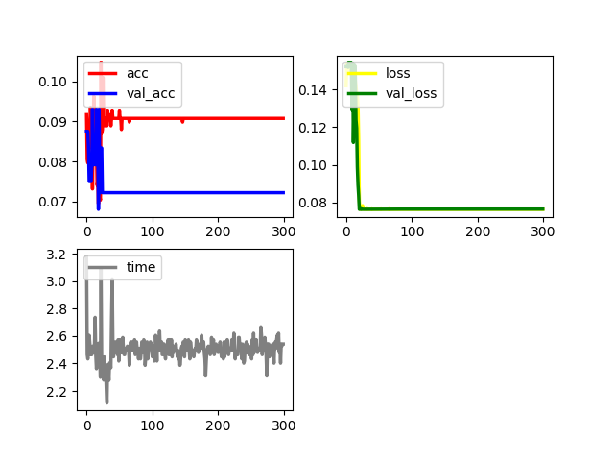
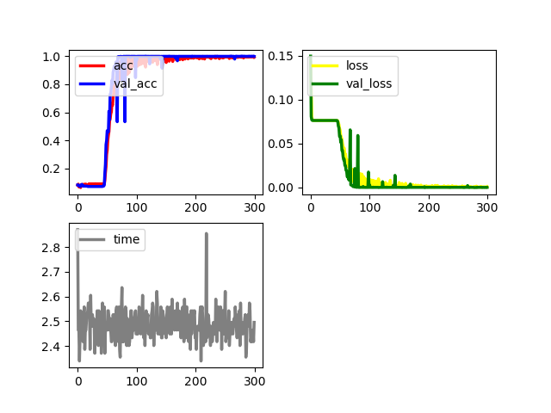
Fontstyle detection on CNNs
Model 3 – 9x9 Kernel
Model 4 – Extra Conv2D Layer

Slide 14
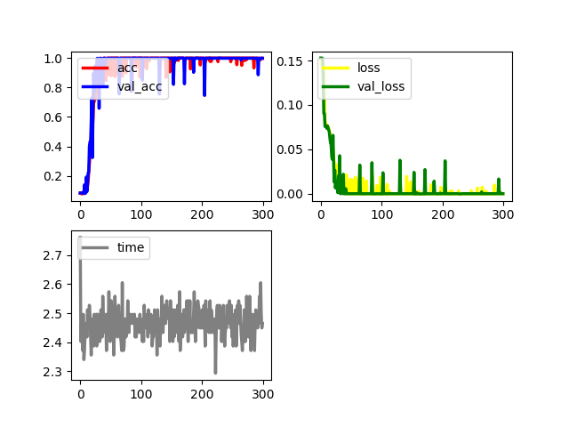
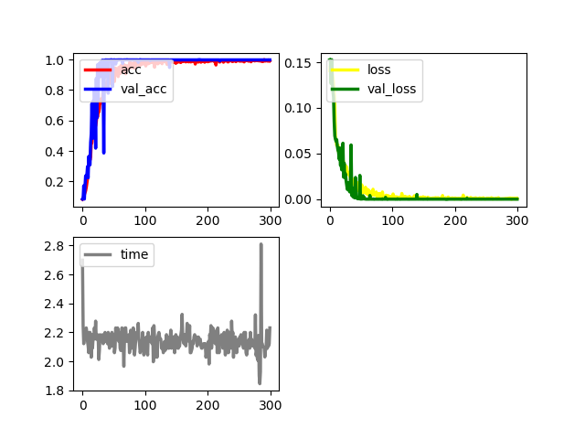
Fontstyle detection on CNNs
Model 5 – Extra Dense Layer
Model 6 – Less Filters

Slide 15
Review
Not every CNN works
Small changes could break the CNN
Random does matter
Bigger != better
Fast or nothing

